Slide 1
Neighbourhood Development Plans
Neighbourhood Development Plans and
the NPPF December 2024

Slide 2
To outline changes to national policy which will have an impact on our communities
To set out our new interim provisional housing requirements and what they mean in practice
To talk with you about Neighbourhood Planning as a mechanism for Communities to face the challenge and what we can do to support you

Slide 3
NPPF December 2024: What this means for us
The governments formula for housing need: the standard method. Includes 5% buffer. Requirement is for the Plan period to 2037
Babergh: Now 775 dwellings (was 416) – 86% increase
Mid Suffolk: Now 734 dwellings (was 535) – 37% increase
A new Plan review. A new Spatial strategy
Interim housing requirement comes with significant caveats and will almost certainly change

Slide 4
Joint Local Development Scheme March 2025
• Scoping and participation stage, including minimum four-month notification of Plan commencement – March 2026 to July 2026.
• Plan visioning and strategy development including first public consultation – August 2026 to March 2027.
• Evidence gathering and draft the Plan – April 2027 to December 2027.
• Second public consultation, proposing changes and submission of the Plan – January 2028 to June 2028.
• Examination of Plan including additional three months for Main Modifications – July 2028 to March 2029.
• Adoption – April 2029

Slide 5
A health warning
Provisional interim figures
Interim provisional requirement calculated proportionate to Parish housing stock
“Policy off”: These figures do not factor in constraints and policies which may affect the spatial strategy and distribution of growth
To assist discussion with Neighbourhood Planning groups about local housing requirements
To inform those considering preparing a plan about the scale of the challenge we all face

Slide 6
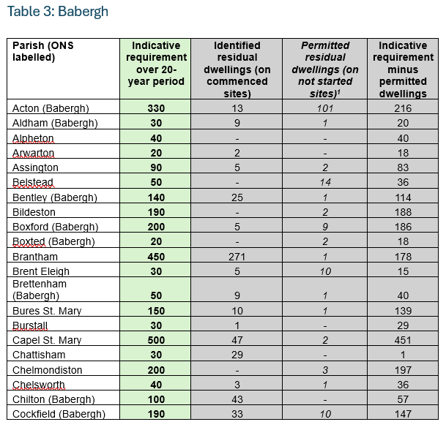
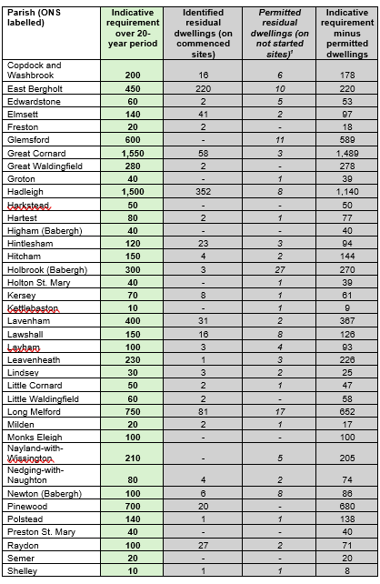
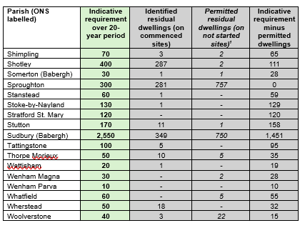
Provisional interim housing requirement: Babergh

Slide 7
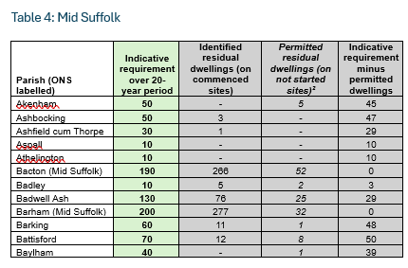
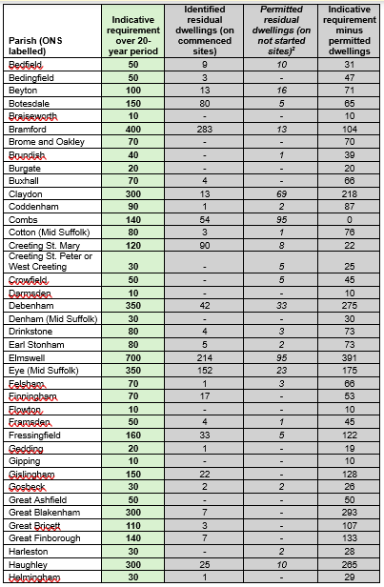
Provisional interim housing requirement: Mid Suffolk (1)

Slide 8
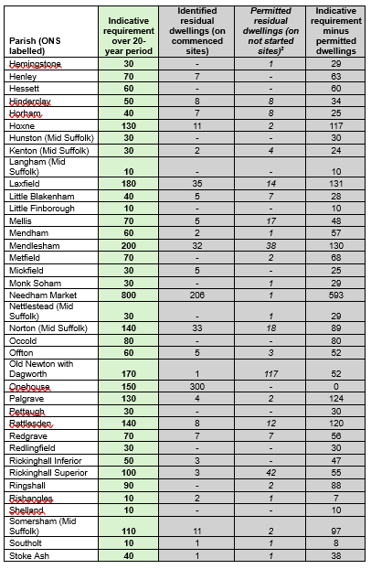
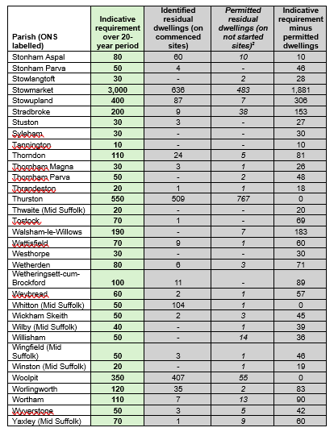
MSDC (2)

Slide 9
Our place based support
Your Plan. Our shared Issues.
Reducing the risk of non-conformity with NPPF 2024 and our Plan Review. A basic condition for your draft NDP.
Helping you consider the challenge of allocations.
Motivations, opportunities and challenges that may be hidden in plain sight
Helping you to ensure you have the greatest chance of success with your plan at Examination

Slide 10
Taking stock
What has held you back from preparing a Neighbourhood Plan?
If you’ve started the work but stopped, what got in the way?
If you’ve had second thoughts, what were they?
Given what we’re told you today, do you feel more inclined to start a plan ?

